Slide 1
CSE 201: Data Structures
Lecture 9: Graphs
Dr. Vidhya Balasubramanian

Slide 2
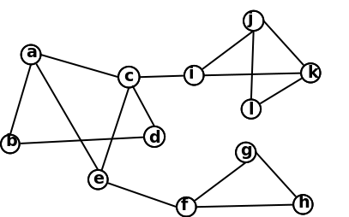
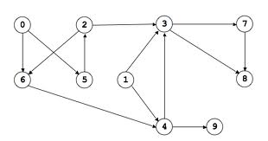
Graphs
A graph G= (V,E) is a set of vertices V, and a collection of edges E which is a subset of VxV
A way of representing connections between pairs of objects from some set V
  Edges can be either directed or undirected
www.cs.princeton.edu

Slide 3
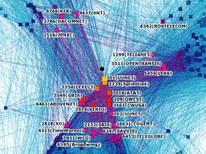
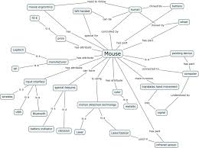
Examples
www.visualcomplexity.com
http://t1065550.files.wordpress.com/2012/02/mouse.jpg

Slide 4
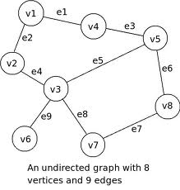
Definitions
End vertices are end points of edges
  v1 and v2 end vertices of e2
Edges incident on a vertex
  e9 incident on v6
Adjacent vertices (end pts of an edge
  v1, v2 adjacent
Degree of vertex is number of edges incident on it
Parallel edges connect same set of vertices
Self loop, edge connecting same vertex

Slide 5
Definitions
Path
  Sequence of alternating vertices and edges
  Eg: P1=(v1,v2,v3,v6)
  Simple path
    Vertices and edges are distinct
      e.g P1
    v1,v2,v3,v7,v3,v6, not simple
Cycle
  Path that ends at start node
  v2,v1,v4,v5,v3,v2

Slide 6
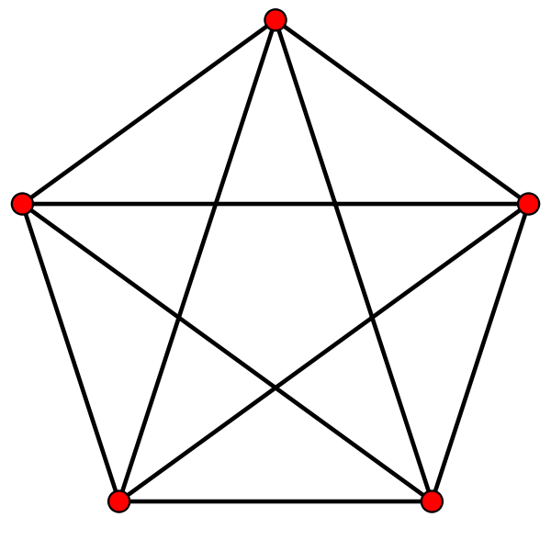
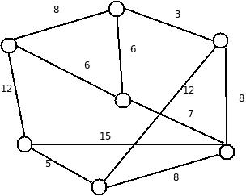
Definitions
Independent edges: don't have common vertices
Complete graph: Every node adjacent to each other
Simple Graph: Has no loops or parallel edges
Independent edges
Complete Graph
adjacent
Simple Graph
(no loops, parallel edges)‏

Slide 7
Definitions contd
Degree: Number of edges incident at a vertex
  Min degree of G --> (G) = min {d(v)| v \in V}
Total degree of G is 2m (number of edges)‏
Number of vertices of odd degree is always even in a graph
In an undirected simple graph
  m ≤ n (n − 1)/2, where n is number of vertices
Proof: each vertex has degree at most (n − 1)

Slide 8
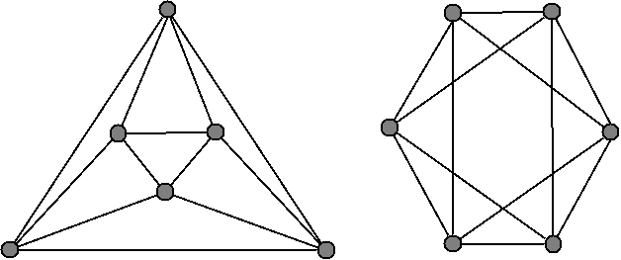
Definitions contd
Planar Graphs: Graph whose edges intersect only at their end
Graph Isomorphism
  Two graphs G and H are isomorphic if
    They have same number of vertices
    A pair of nodes are adjacent in G iff a corresponding pair exists in H

Slide 9
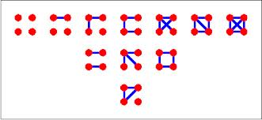
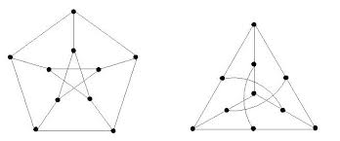
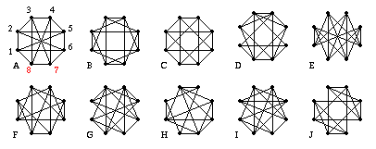
Example: Isomorphism
http://upload.wikimedia.org/
http://www.sonoma.edu/
http://www.math.tamu.edu/~sottile/teaching/98S/figures/hard_iso.gif

Slide 10
Graph ADT
Accessor methods
  isVertex()
  incidentEdges(v)
  endVertices(e)
  isDirected(e)
  origin(e)
  destination(e)
  opposite(v, e)
  areAdjacent(v, w)
Update methods
  insertVertex(x)
  insertEdge(v, w, x)
  insertDirectedEdge(v, w, x)
  removeVertex(v)
  removeEdge(e)
Generic methods
  numVertices()
  numEdges()
  vertices()
  edges()

Slide 11
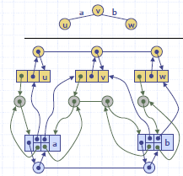
Graph Representations
Adjacency list
  Each vertex has incidence container
    List of vertices adjacent to it or edges incident on it
  Edge list
Augmented edge objects
  references to associated positions in incidence sequences of end vertices

Slide 12
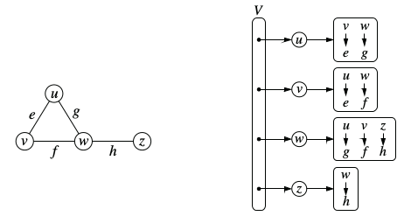
Adjacency Map
Similar to adjacency list
  secondary container of all edges incident to a vertex is organized as a map, rather than as a list
  adjacent vertex serves as a key to the edge
Allows for fast access to a particular neighbor

Slide 13
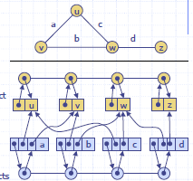
Edge List Representation
Vertex object
  Element
  reference to position in vertex sequence
Edge object
  element
  origin vertex
  destination vertex
  reference to position in edge sequence
Vertex sequence
  Sequence of vertices in G
Edge sequence
  Sequence of edge objects

Slide 14

Adjacency Matrix
Edge list
2D-array adjacency array A where
  A[i,j] is 1 if there is an edge between vertices i and j
  A[i,j] =0, if there is no edge incident on i and j
 | u | v | w
u | 0 | 1 | 0
v | 1 | 0 | 1
w | 0 | 1 | 0

Slide 15
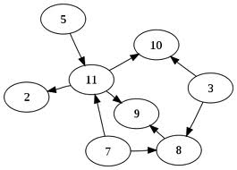
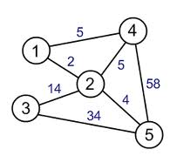
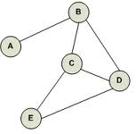
Exercises
Represent the following graphs using the three representations
Suppose we represent a graph G with n vertices and m edges with edge list structure. Why does the function insertVertex() function take O(1) time, while removeVertex() function runs in O(n) time

Slide 16
Exercises
Would you use the adjacency list structure or the adjacency matrix structure for the following cases? Justify.
  The graph has 10,000 vertices and 20,000 edges and it is important to use as little space as possible
  The graph has 10,000 vertices and 20,000,000 edges and it is important to use as little space as possible
  You need to answer the query areAdjacent(v,w) as fast as possible, no matter how much space you use

Slide 17
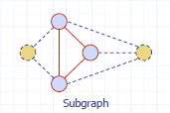
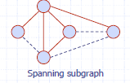
Subgraphs
A subgraph S of a graph G is a graph such that
  The vertices of S are a subset of the vertices of G
  The edges of S are a subset of the edges of G
A spanning subgraph of G
  is a subgraph that contains all the vertices of G

Slide 18
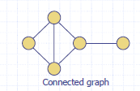
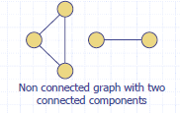
Connectivity
A graph is connected if there is a path between every pair of vertices
Connected component of G
  Maximally connected subgraph of G

Slide 19
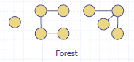
Trees and Forests
A tree is an undirected graph such that
  T is connected
  T has no cycles
  Need not be rooted
Forest is an undirected graph without cycles
  Connected component of a forest are trees

Slide 20
Graph Traversal
Depth first search
  Recursive – O(m+n) algorithm
  Start with some node v
    Of all neighbors of v, goto next w which is unexplored do DFS(w)‏
    If w explored, then mark edge as back edge
Similar to a Maze traversal
  Mark each intersection, corner and dead end (vertex) visited
  Mark each corridor (edge ) traversed
  Keep track of the path back to the entrance (start vertex) by means of a rope (recursion)

Slide 21
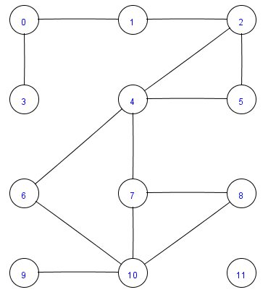
DFS Example

Slide 22
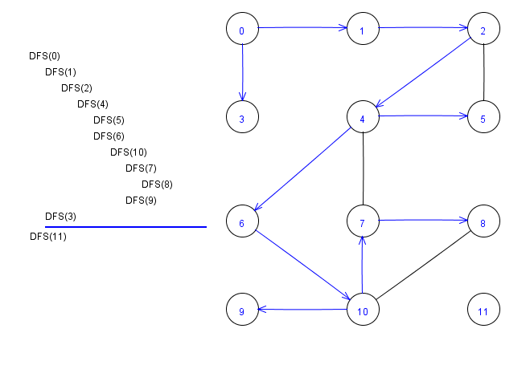
DFS Example Contd

Slide 23
DFS
Algorithm DFS(G,v)
for all edges e in G do
  if e is unexplored then
  w ← G.opposite(v,e)
  if w is unexplored then
    label e as a discovery edge
    DFS(G,w)
  else
    Label e as back edge

Slide 24
DFS Properties
DFS(G, v) visits all the vertices and edges in the connected component of v
The discovery edges labeled by DFS(G, v) form a spanning tree of the connected component of v
  Spanning tree is a tree which contains
    All the nodes in the connected component
    Subset of edges connecting all the nodes in the component such that no cycles are formed

Slide 25

DFS Applications
Path finding
  Can be used to find path between two vertices
Cycle Finding
  Usually a cycle is a sequence of forward edges with one backward edge
    Backward edge indicates an already visited node

Slide 26
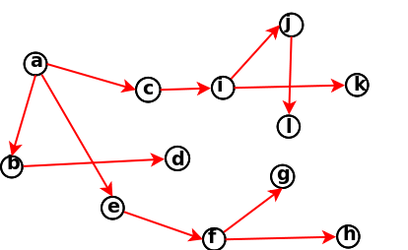
Breadth First Traversal
Discovery in levels, marks new nodes in levels
O(m+n)

Slide 27
Breadth First Traversal
Discovery in levels, marks new nodes in levels
  Cross edges connect to already discovered nodes
O(m+n)

Slide 28
BFS
Algorithm BFS(v)
initialize container L0 to contain vertex v and i to 0
while Li is not empty do
  for each vertex v in Li do
    for each edge e incident on v
      if e is unexplored
        let w be the other endpoint of e
        If w is unexplored
          label e as a discovery edge and insert w into Li+1
        else label e as cross edge
  i ← i+1

Slide 29
Applications of BFS
Find and report a path with the minimum number of edges between two given vertices
Find a simple cycle, if there is one

Slide 30
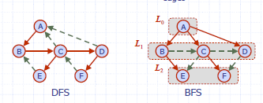
BFS vs DFS

Slide 31
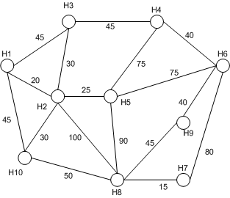
Exercises
Do the BFS and DFS traversal over the following graph
Illustrate all possible structures of traversal trees generated on a wheel graph Wn

Slide 33
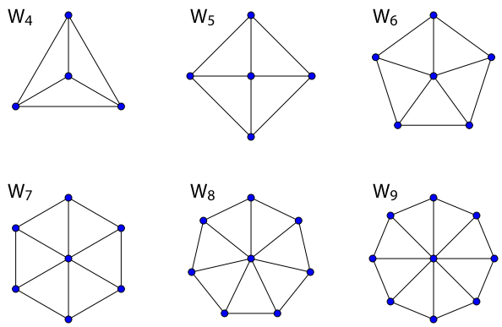
Exercise

Slide 34
Exercise
How are the DFS and BFS modified for a directed graph?
Write an algorithm to find the longest path in a DAG, where the length of the path is measured by the number of edges that it contains.

Slide 35
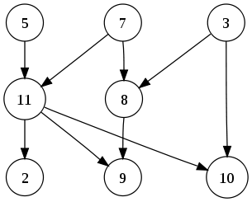
Digraphs
A directed graph or digraph is a pair G =(V,E) of
  a set V, whose elements are called vertices or nodes
  a set E of ordered pairs of vertices, called arcs, directed edges, or arrows
A directed acyclic graph (DAG) is a directed graph with no directed cycles

Slide 36
Digraph Applications
Used to model several kinds of structures in maths or science
Scheduling
  Edge (a, b) indicates task a must be completed before b
Topological Ordering
Data Processing Networks
  data enters a processing element through its incoming edges and leaves the element through its outgoing edges
  Bayesian Networks
  Compilers
  Circuit Design

Slide 37
Topological Ordering
A DAG is a digraph that has no directed cycles and a topological ordering of a digraph is a numbering v₁ , ..., v_{n} of the vertices such that
  for every edge (v_{i} , v_{j}), we have i < j
Example
  In task scheduling, a topological ordering is a task sequence that satisfies the precedence constraints
Theorem
  A digraph admits a topological ordering if and only if it is a DAG

Slide 38
Example
For the above graph these are some valid topological ordering
  5, 7, 3, 11, 8, 2, 9, 10
  3, 5, 7, 8, 11, 10, 9, 2

Slide 39
Topological Sorting Algorithm
Let S be an empty stack
For each vertex u of G, set incounter(u) as the indegree(u)
  If incounter(u) =0, push it in the stack
Set i as 1
If S is empty it has a directed cycle
Pop the ith vertex u_{i} from the stack and increment i
  For each neighbor v of u_{i}, decrement incounter(v) by 1
  If incounter(v) =0, push it in stack
  Do this this while stack has elements in it

Slide 40
Example
0
C
Push C
1
G
1
A
1
B
1
D
E
3
3
F
H
1

Slide 41
Example
0
C
Pop C
In Stack
B
A
G
0
G
0
A
0
B
1
D
E
3
2
F
H
1

Slide 42
Example
0
C
Pop B
In Stack
G
A
0
G
0
A
B
1
1
D
E
2
2
F
H
1

Slide 43
Example
0
C
Pop A
Push D
In Stack
D
G
0
G
A
2
B
1
0
D
E
1
2
F
H
1

Slide 44
Example
0
C
Pop D
Push E
In Stack
E
G
0
G
A
2
B
1
3
D
E
0
1
F
H
1

Slide 45
Example
C
Pop E
Push F
In Stack
F
G
0
G
A
2
B
1
3
4
D
E
0
F
H
1

Slide 46
Example
0
C
Pop F
Push H
In Stack
H
G
0
G
A
2
B
1
3
4
D
E
5
F
H
0

Slide 47
Example
C
Pop H
Pop G
7
G
A
2
B
1
3
4
D
E
5
F
6
H

Slide 48
Analysis
Runs in O(n+m) time – n vertices and m edges
  Initial computation of indegree O(n+m)
Uses O(n) auxiliary space (stack)
If some vertices are not numbered then there is a cycle
  Any vertex on a directed cycle will not be visited
  A vertex visited only when incounter is 0
  Implies all its previous predecessors were previously visited

Slide 49
Exercise
A student entering the computer science department wants to plan his course schedule to take the following courses: The course prerequisites are:
  CS105 – none
  CS106 – CS105
  CS122 – none
  CS201 – CS105
  CS202 – CS106, CS201
  CS326 – CS122, CS202
  CS327 - CS106
  CS141 – CS122, CS106
  CS169 – CS202
Find a sequence of courses that allows Bob to satisfy all the prerequisites

Slide 50
Exercise
The root of a DAG is a vertex R such that every vertex of the DAG can be reached by a directed path from R. Write an algorithm that takes a directed graph as input and determines the root (if there is one) for the graph. The running time of your algorithm should be (|V| + |E|).

Slide 51
Minimum Spanning Tree
Given a weighted undirected graph G, goal is to find a tree T such that
  T contains all vertices in G
  Sum of weights of edges in T is minimum

